Slide 1
Vending Machine: State Machine and Code Examples
CSE 460

Slide 2
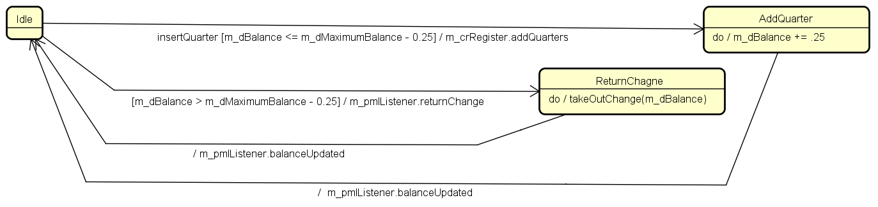
PayMachine
We only model a part of the class:
Adding a quarter (insertQuarter method in PayMachine.java)
Returning change (returnChange method in PayMachine.java)
Could be in one of 3 phases: Idle, ReturnChange, AddQuarter

Slide 3
Cash Register
Could be in one of Idle, TakeChange, TakeQuarters, TakeDimes, TakeNickels phases
We only model the following parts:
Taking back the change
Adding a quarter
Look at the method takeOutChange in CashRegister.java.

Slide 4
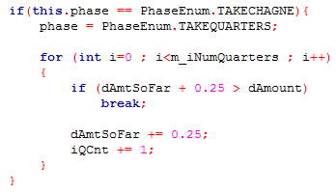
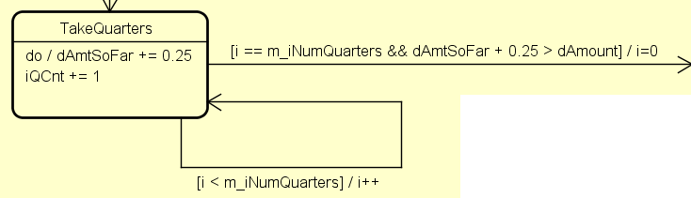
State Machine design and code snippets

Slide 5
